Slide 1
Simulations Part 1

Slide 2
Types of Probabilities
Theoretical Probabilities
Experimental Probabilities

Slide 3

Theoretical Probabilities
Example: What is the probability of getting a head when flipping a coin?

Slide 4
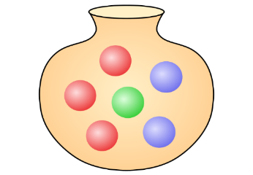
Example: Suppose you have an urn with 6 marbles: 3 are red, 2 are blue, and 1 is green. Suppose you draw one marble at random from the urn, what is the probability that the marble is red?

Slide 5

Example: If you roll a fair six-sided die once, what is the probability that you get a 6?
Example: If you roll a fair six-sided die once, what is the probability that you get an even number?

Slide 6
How do we compute Theoretical Probabilities?

Slide 7
Experimental Probabilities
Example: Flip a coin 100 times and observe 32 heads. Find the probability of getting a head in a coin flip.

Slide 8
Coin Experiment
Experiment: Flip a coin 20 time and record your observations in every flip. Record your observations below, then compute the experimental probability of getting a head.

Slide 9
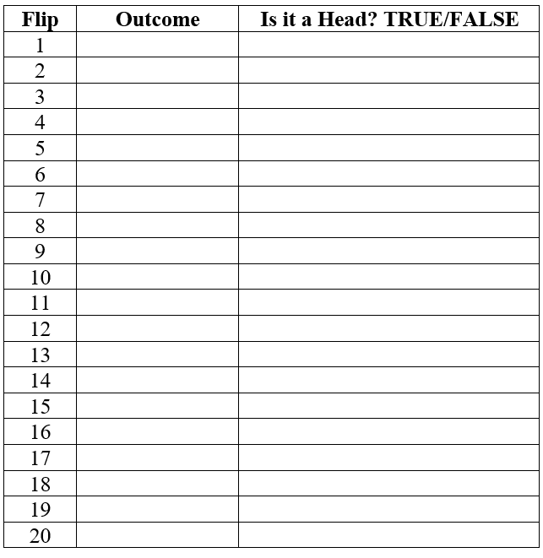

Slide 10
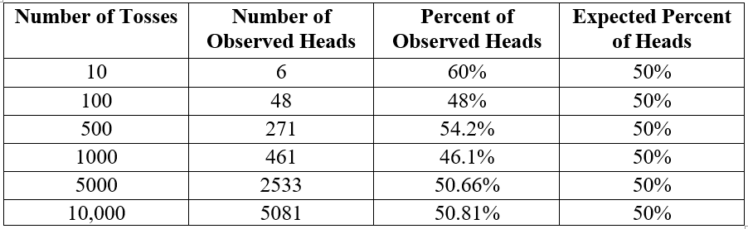
Law of Large Numbers
Law of Large Numbers: In the long run, as the number of trials increases and increases, the proportion of the outcomes get closer to the theoretical probability values.

Slide 11
Sample Function
sample(vector, n)

